Slide 1
Living systematic reviews
Kansas proposal
https://openmetaanalysis.github.io/

Slide 2
My background
Lot of years in Texas
Tradition publishing - top-down, hierarchical system. Room to improve?
Proposal
Will living reviews, which shift work from searching to interpreting, help you regardless of whether you are a clinician educator or researcher, augment your work?
San Antonio was nice, but...

Slide 3
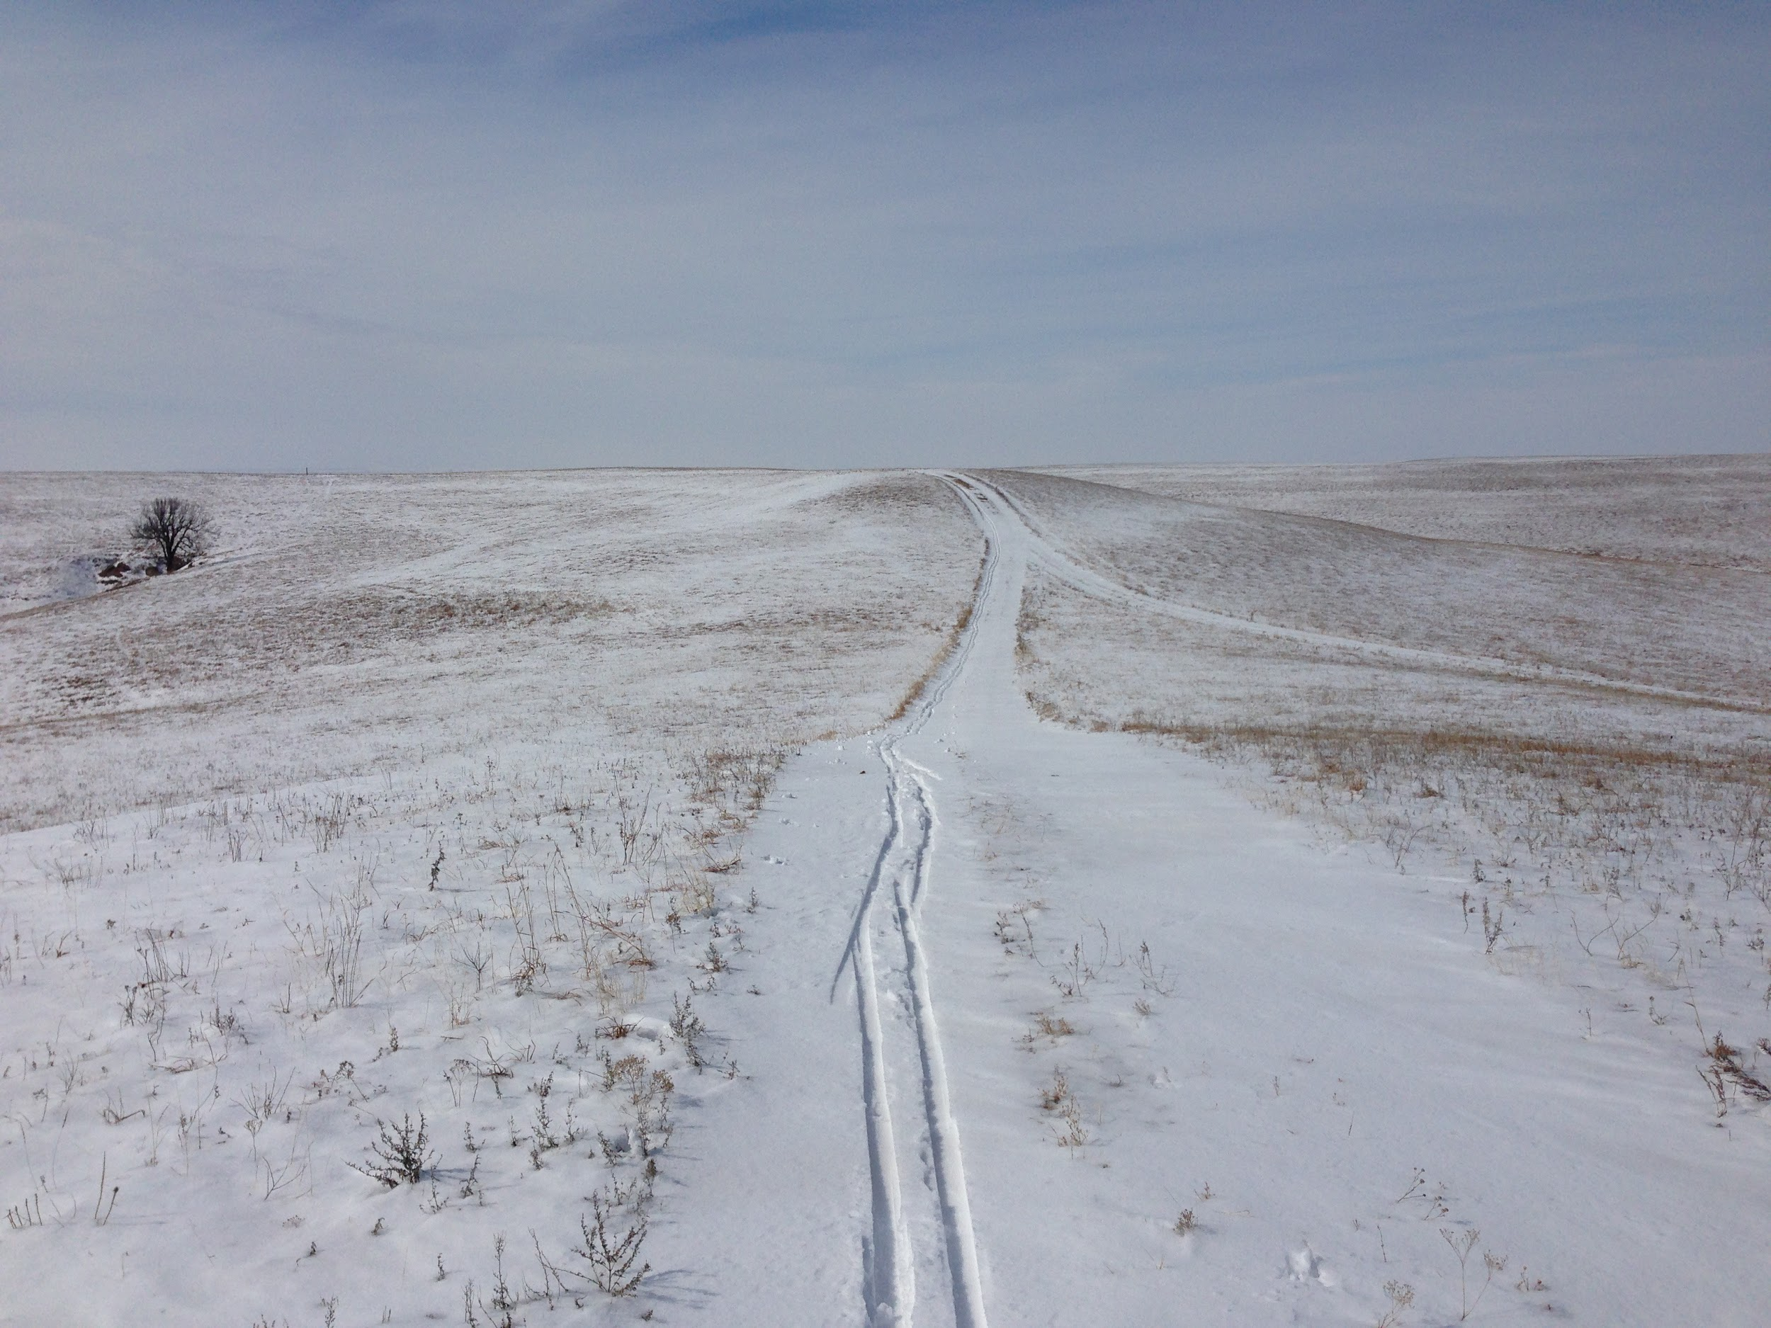
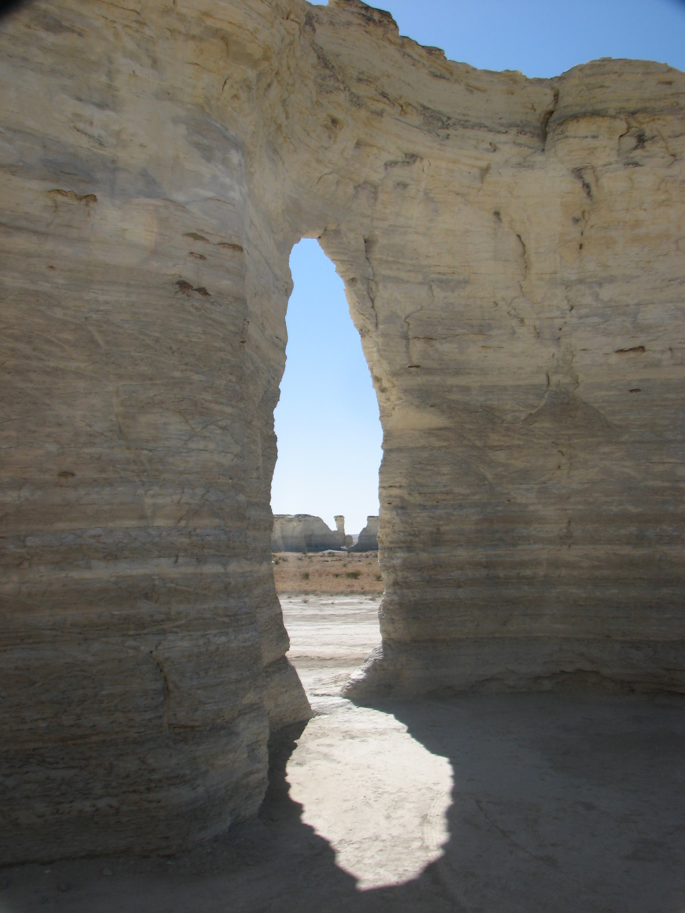

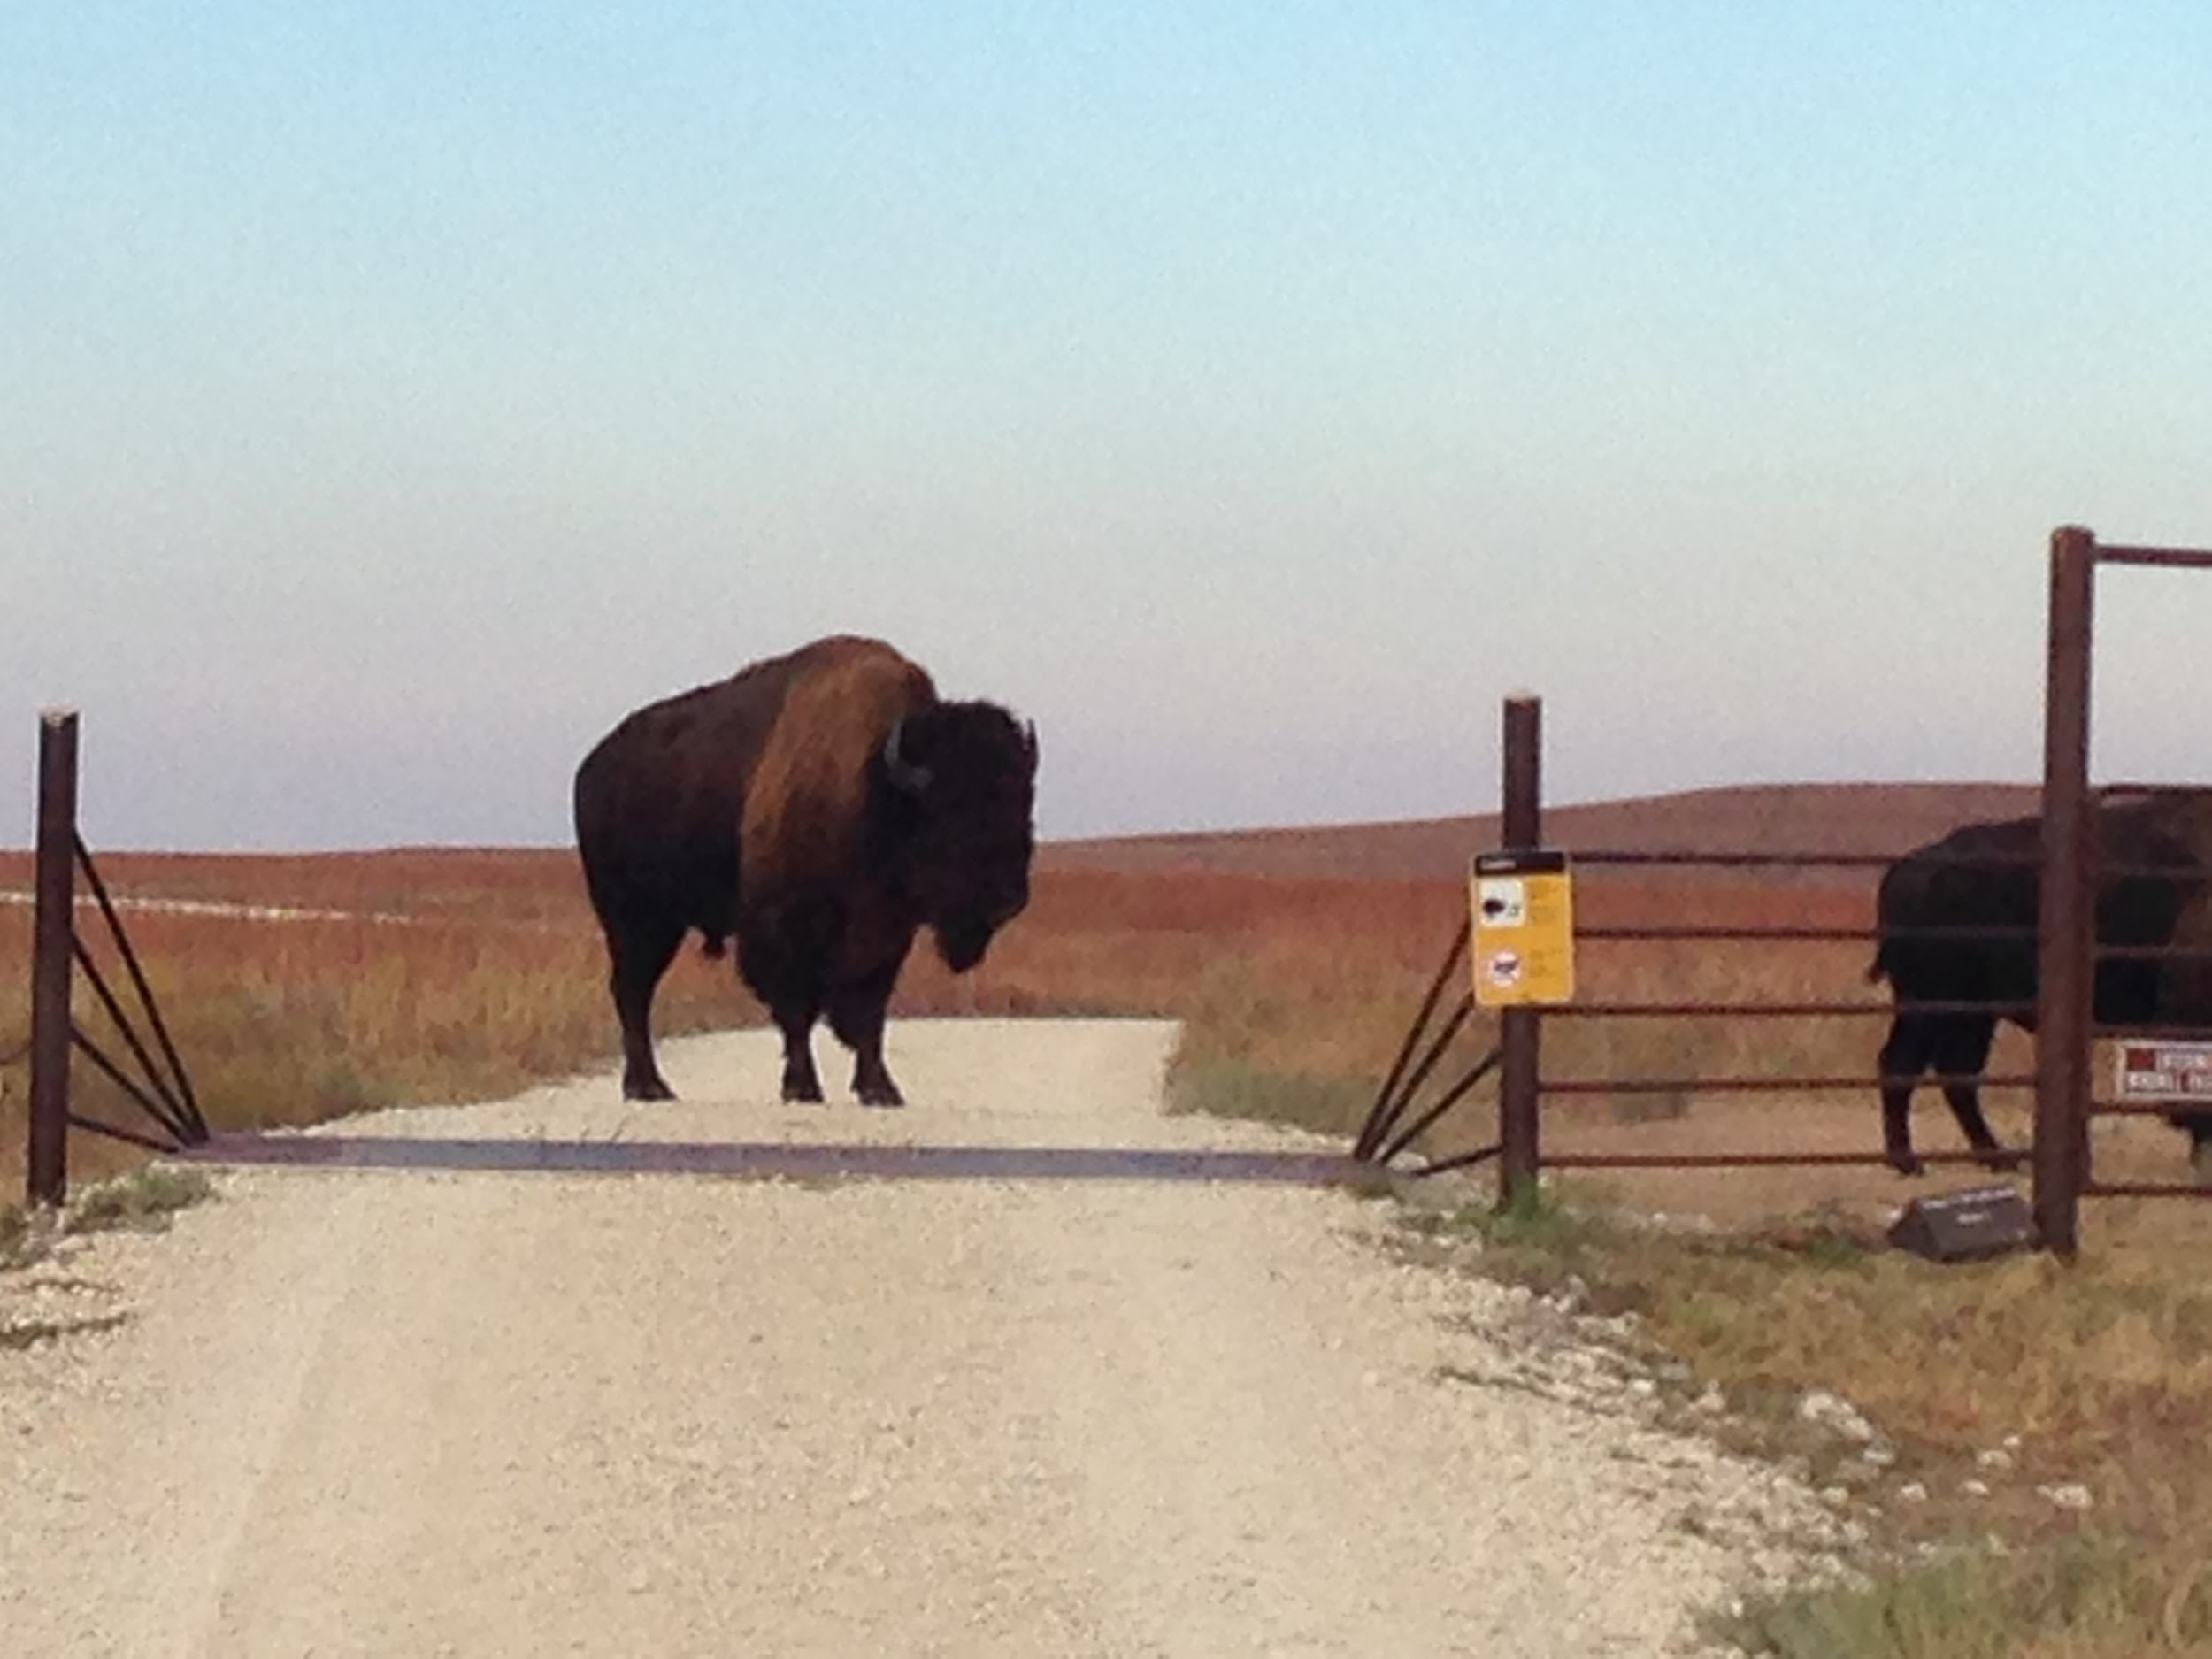
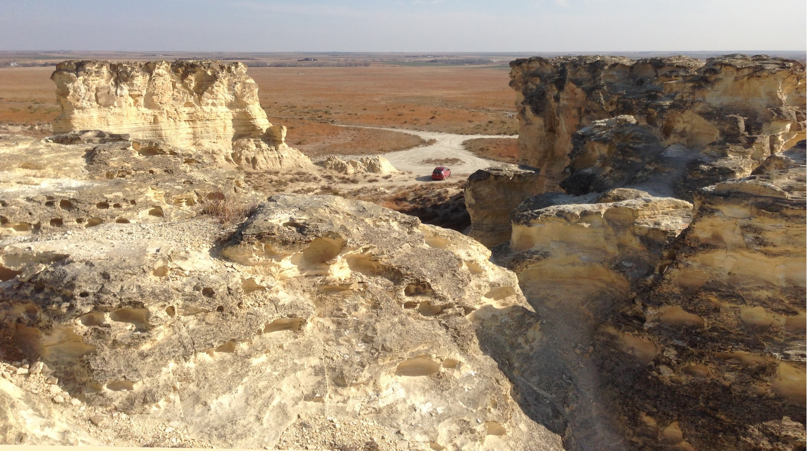
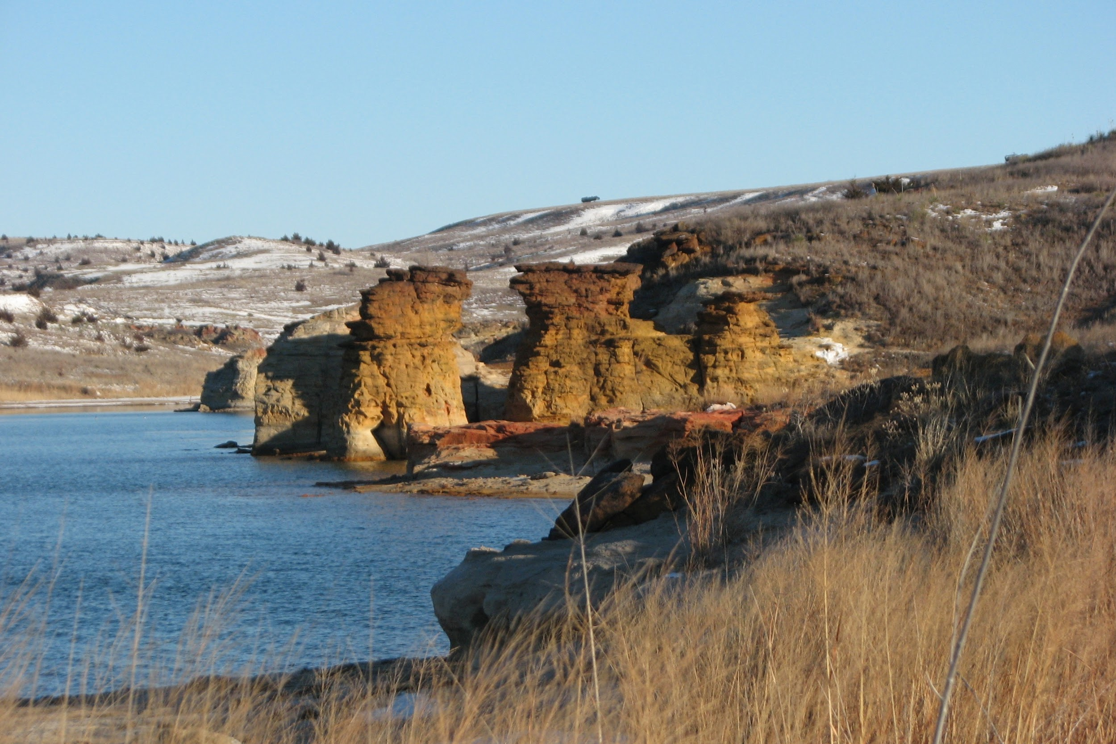

Slide 4

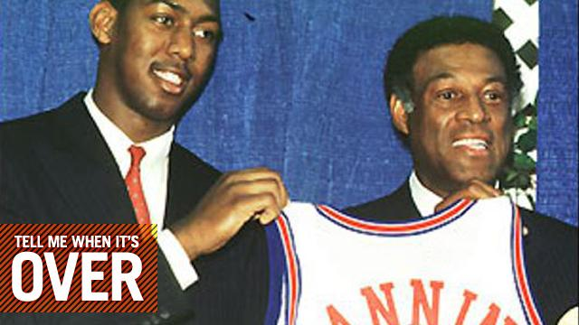
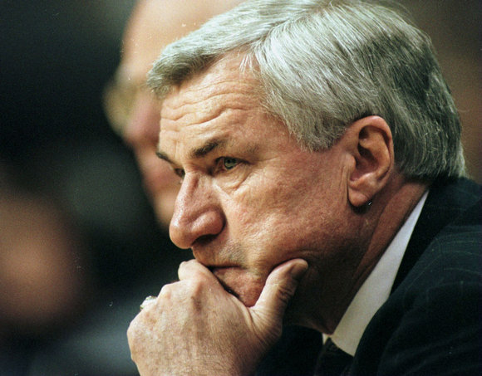



Slide 5
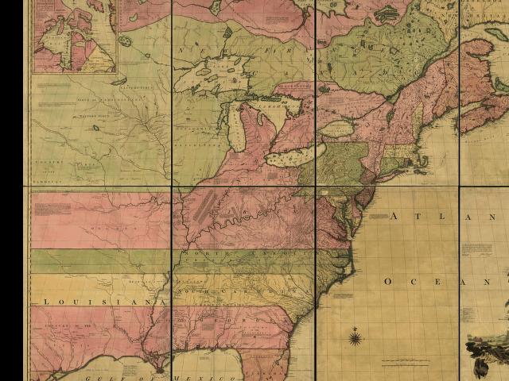
Second Virginia Charter, 1609

Slide 6

Problem with meta-analyses
7% outdated at the time of publication (PMID: 17638714)
67% overlap with a second meta-analysis (PMID: 23873947)
Onerous to conduct

Slide 7
An idea
Elliott et al. Living systematic reviews: an emerging opportunity to narrow the evidence-practice gap. PLoS Med. 2014 PMID: 24558353
Grewal S, Klassen TP. The tale of 2 trials: disentangling contradictory evidence on hypertonic saline for acute bronchiolitis. JAMA Pediatr. 2014 PMID: 24862208
But how to do this technically and socially?

Slide 8


Slide 9
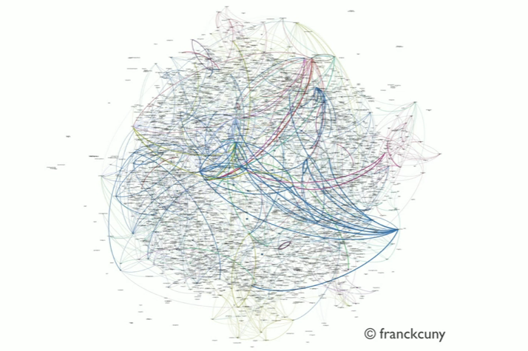
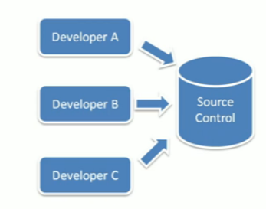
The evolution of programming
Notes:
Cooperation without coordination

Slide 10


Slide 11
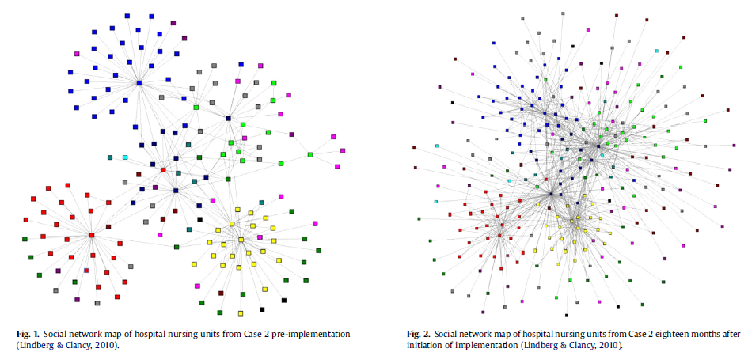
Complexity science in health care delivery

Slide 12
Complexity science meets meta-analysis
Traditional
Cochrane
AHRQ
Open-source Collaborative coding
R
GitHub
OpenCPU
Leads to living systematic reviews
Hartung-Knapp estimator & Confidence Intervals for I²
Both approaches are needed

Slide 13
“OpenMeta-analysis”
1: Badgett RG, Vindhyal M, Stirnaman JT, Gibson CM, Halaby R. A Living Systematic Review of Nebulized Hypertonic Saline for Acute Bronchiolitis in Infants. JAMA Pediatr. 2015 Aug;169(8):788-9. PMID: 26099054. 2: Ters P, Badgett RG. A living meta-analysis of colchicine for pericarditis. Ann Pharmacother. 2014 PMID: 25164526.
More under development at http://openmetaanalysis.github.io/

Slide 14
Detail
Methods
Examples
Implications
Barriers

Slide 15
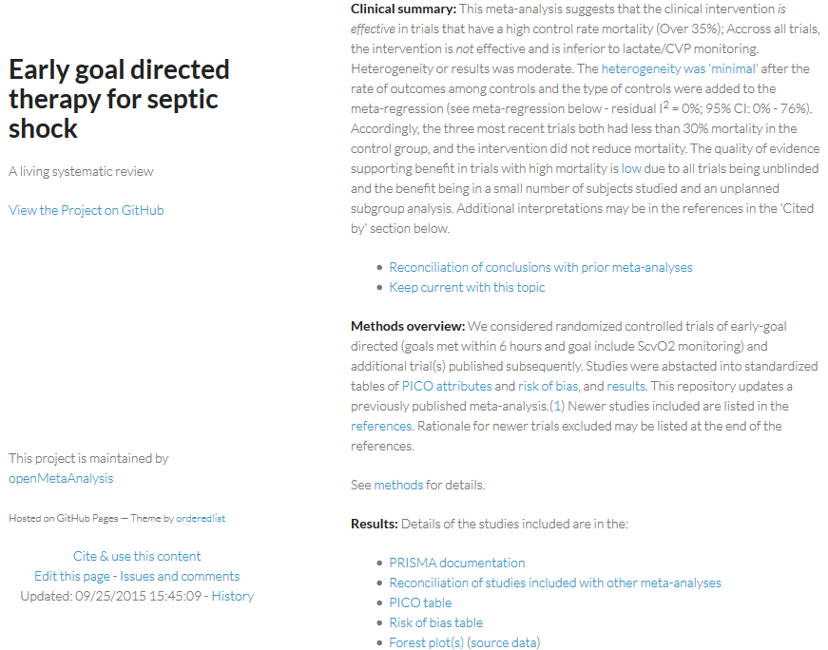
http://openmetaanalysis.github.io/

Slide 16
Methods: searching
Tabulate all studies in last 1- 5 meta-analyses
Add cited reference searches
Studies that cited the seminal papers
Add alerts to PubMed and ClinicalTrials.gov

Slide 17
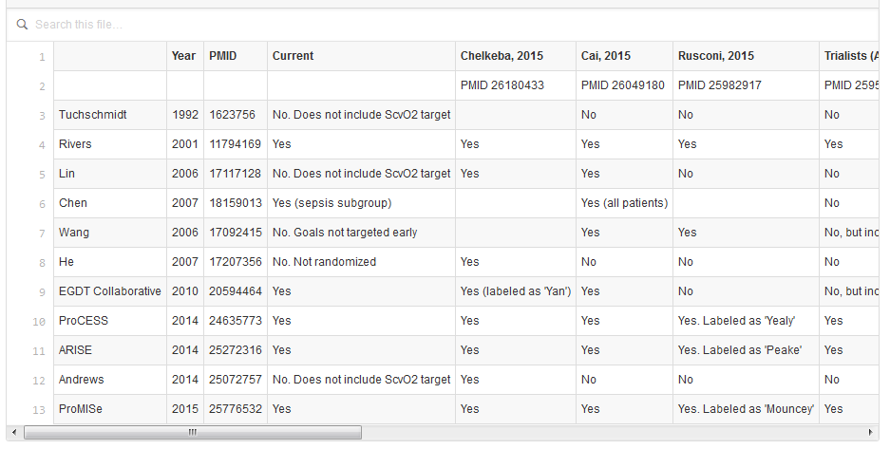
Reconciliation of trials table

Slide 18
Methods: data abstraction
Numbers and results
PICO Table (clinical)
Risk of bias Table (methods)
Use Cochrane Criteria and add
Trial registration present?
Consort flow chart present?

Slide 19
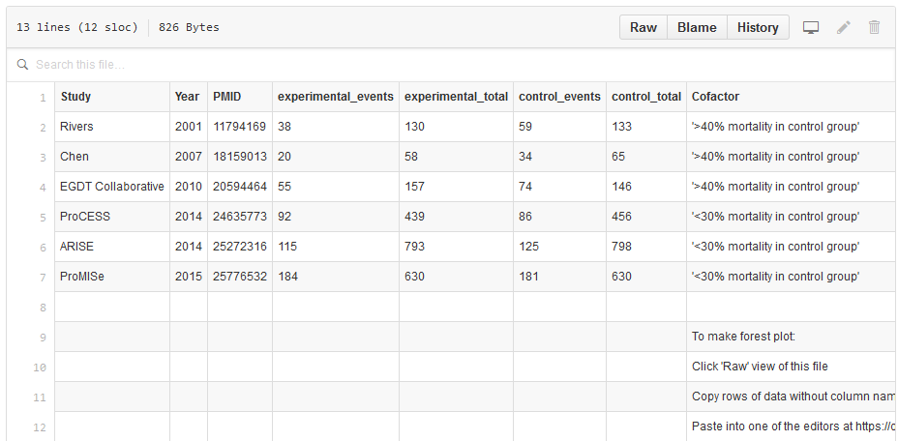
Methods: data abstraction

Slide 20
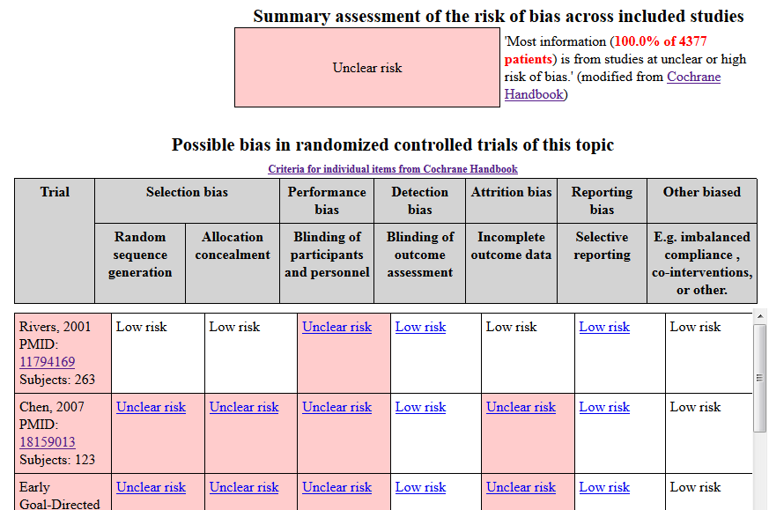
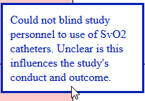
Methods:
data abstraction

Slide 21
Methods: analysis
Meta-analysis of all trials
If heterogeneity
Meta-regression and subgroups
Repeat meta-analysis with subgroups
Are we discovering or creating patterns in the data?
“Test everything. Hold fast to what is good.”
I Thessalonians 5.21
Notes:
Following the Book of Daniel’s first description of a controlled trial (alternative diets), Paul later presaged exploration of heterogeneity with meta-regression

Slide 22
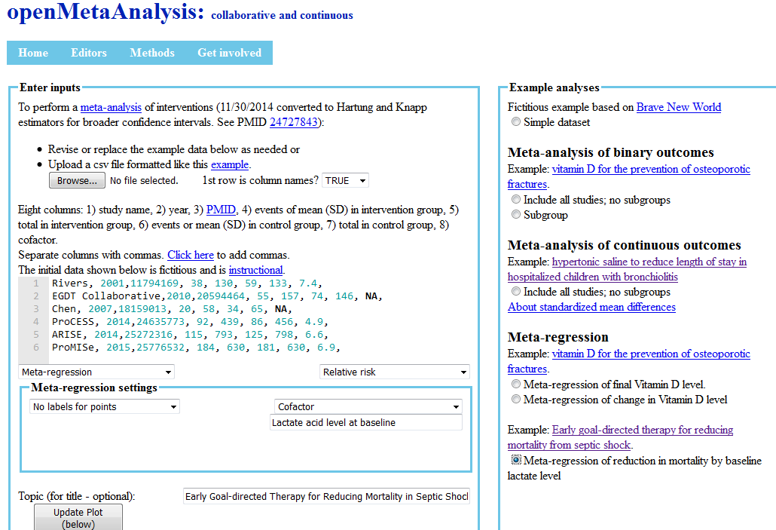

Slide 23
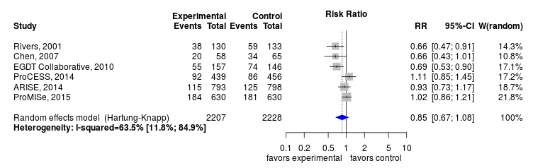
Methods: initial meta-analysis

Slide 24
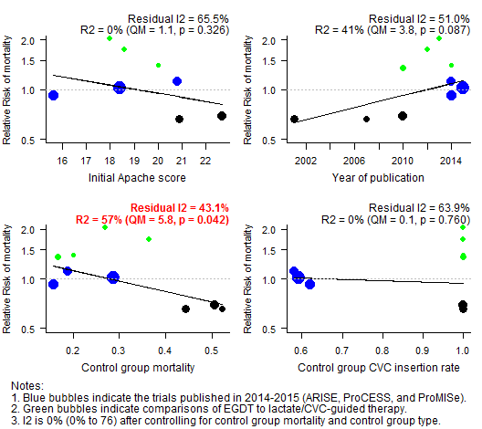
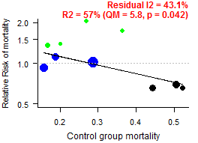
Methods:
meta-regression

Slide 25
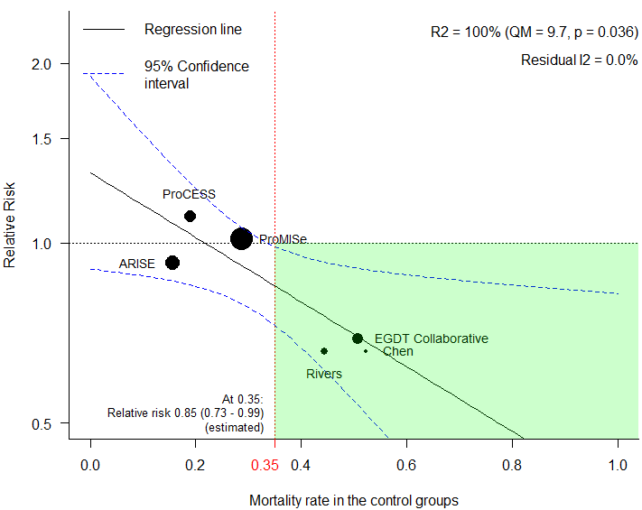
Methods:
meta-regression
of comparisons
to usual care
What may this mean, clinically?

Slide 26
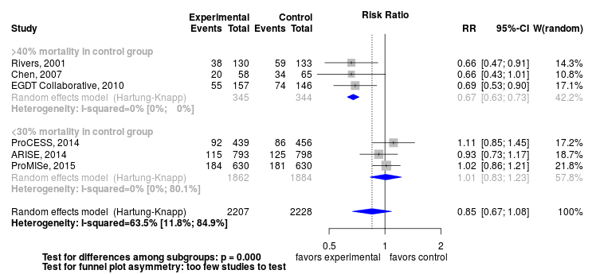
Methods: meta-analysis

Slide 27
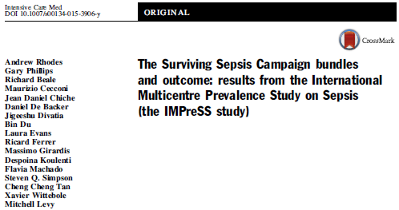
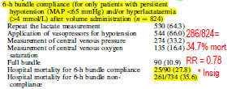

Slide 28
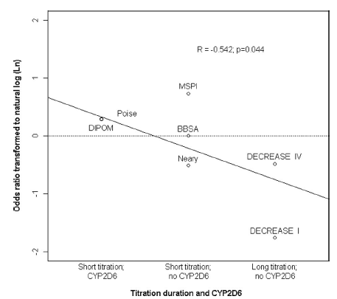
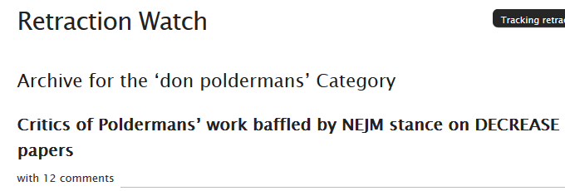
Methods: meta-regression foul
Anesthesiology, 2010. PMID 20693881

Slide 29
Methods: GRADE Summary of findings table (SoF)
GRADE with modifications
Quality of available studies using Cochrane ROB
Cochrane back group (>25%, > 50%)
Heterogeneity (I² > 30%, > 60%)
Imprecision of results (< 300, < 2000)
Publication bias if funnel plot asymmetry or
All studies small
We created an unplanned subgroup

Slide 30
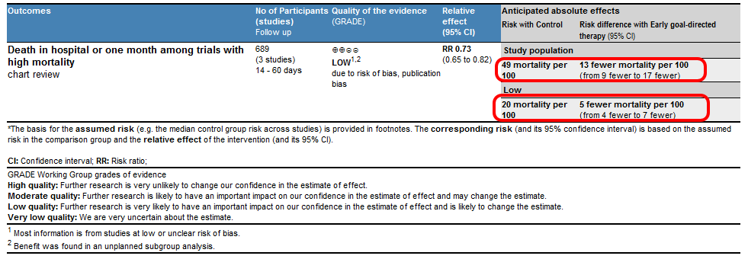
Methods: GRADE Summary of findings table (SoF)

Slide 31
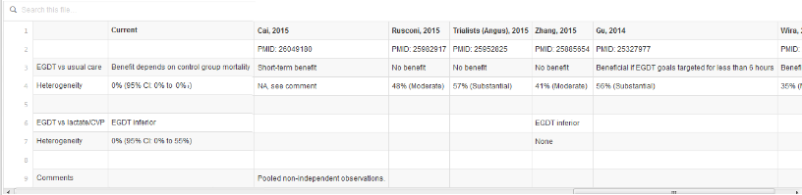
Methods: Reconciliation of conclusions table
Notes:
0% to 0% is only look at the subgroup

Slide 32
Summary of advantages of living reviews
Commoditize work of searching as successive reviews build on prior reviews
Less grunt work of searching so that more time spent on
Exploring and explaining heterogeneity of results
Same fun as diagnosing a complicated patient
Updating as trials studies emerge

Slide 33
Implications
Trials: support applications for funding, human subjects and publication
Lancet does for publication
Education
Learn evidence-based practice by participation
Knowledge dissemination
Incorporate savvy clinicians on review team
Wikidoc blobbogram versus bulky prose of UpToDate
Test new methods

Slide 34
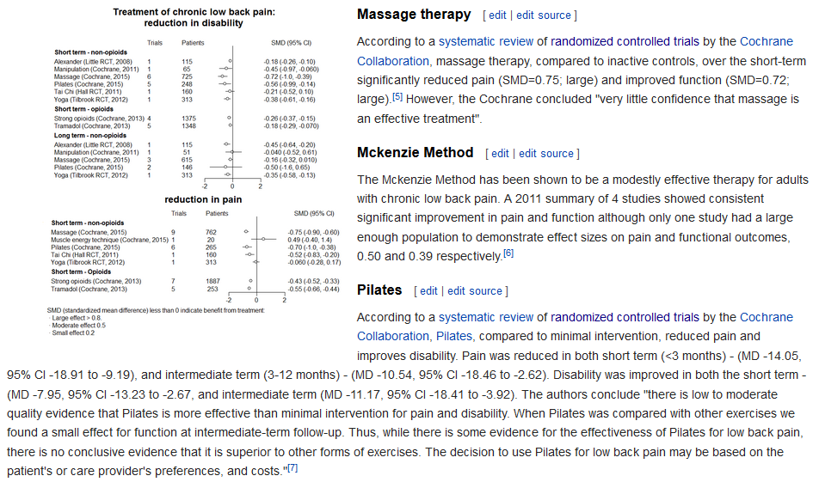
Implications
WikiDoc

Slide 35
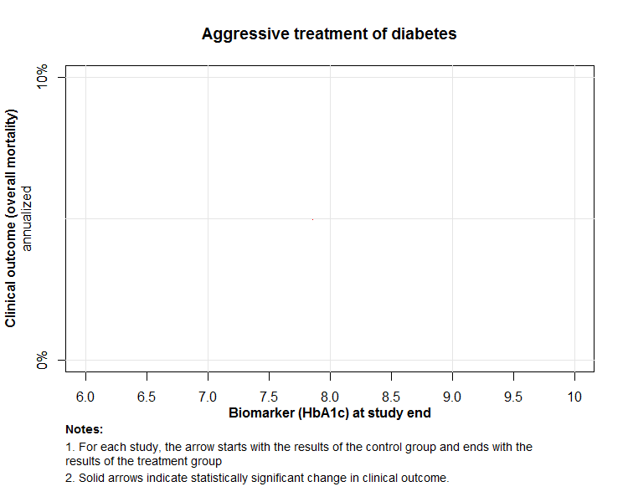
Arrow plot
Control group at study end
Treatment group at study end

Slide 36
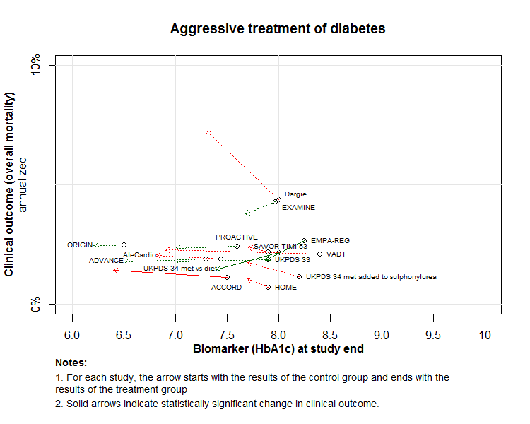
Arrow plot
Better?
Metformin
DPP4s
Renal selective SGLT-2s

Slide 37
Issues to resolve
Technical
Revising images
Editing tables
Social
Who executes the reviews
Academic credit?
Credibility - epidural steroids (Annals’s concern)

Slide 38
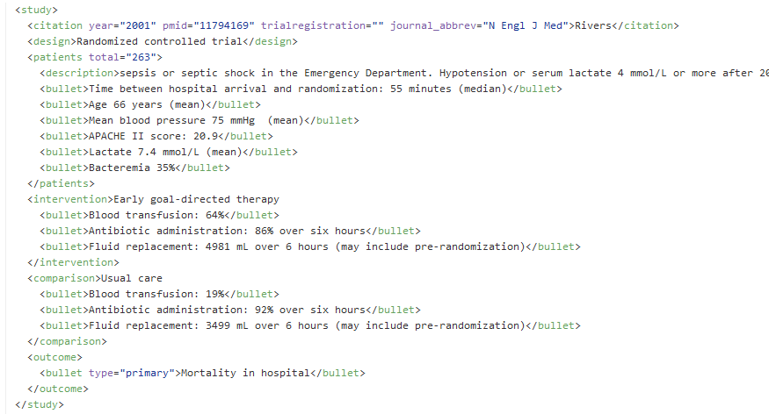

Slide 39
Issues: who executes
At the time of the last trial publication
Author (as done by Lancet)
Journal?
Independent of last trial?
Stand alone review
Letter to the editor?

Slide 40
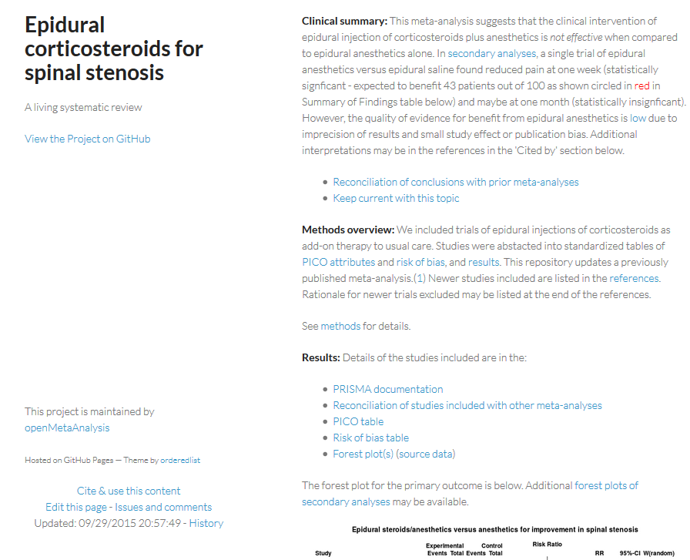
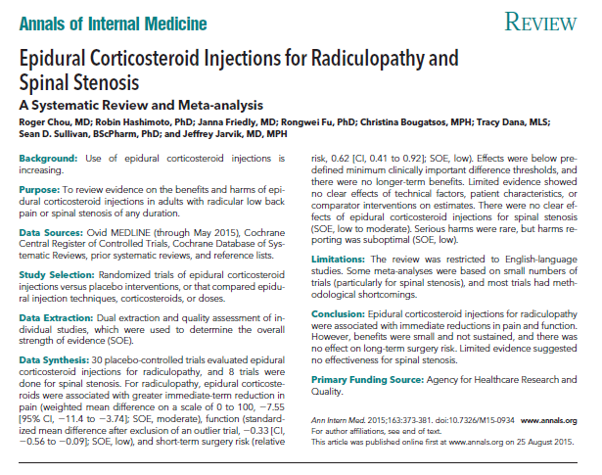
Credibility
=?

Slide 41
Questions? Acknowledgement: Jason Stirnaman (Formerly of Dykes Library)

